Slide 1
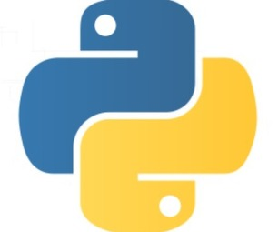
Introduction To Python

Slide 2

Objective
At the end of this module, we will able to :
Understand Python- an object oriented Programming Language.
List the user of python for Data Analytics.
Defining Identifiers and Indentation.
List operations on Number.
Run a python script
Basic of Python(Variable, Data Types)
Python Input / Output

Slide 3
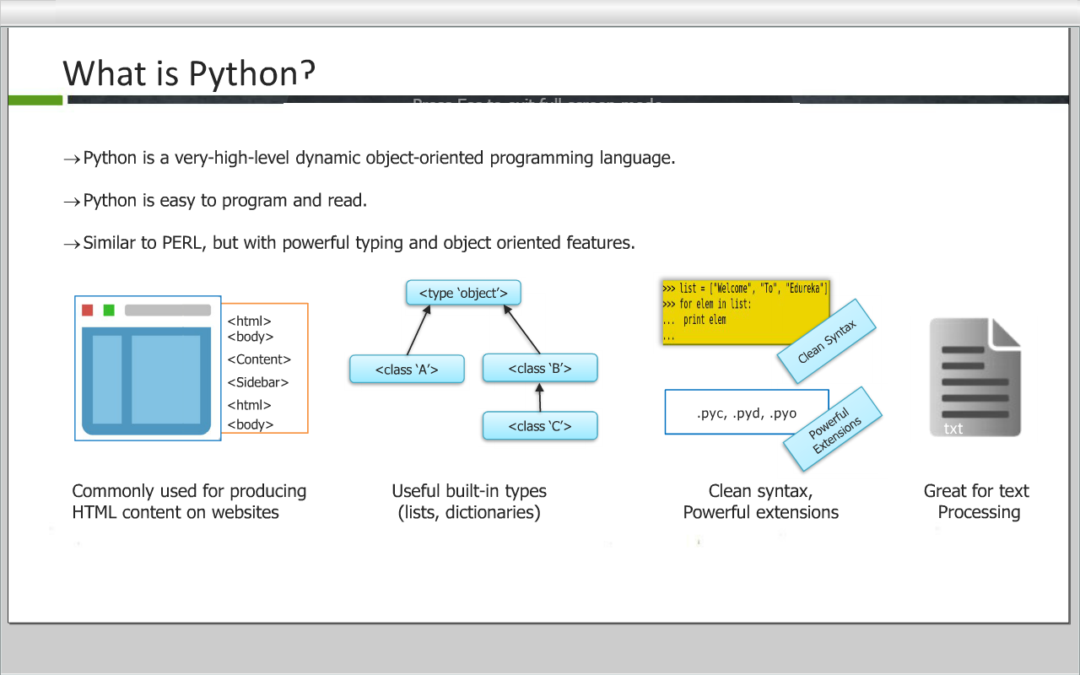
What is Python
Python is a high-level dynamic object-oriented programming language.
Python is easy to program and read.

Slide 4

Why Python
Software Quality
Developer Productivity
Program Portability
Support Library
Component Integration
Pyhton programs run unchanged on all major computer platforms. (Windows, linux, Mac OS etc)
Python comes with a large collection of prebuilt and portable functionalty known as Standard Library.
Python code is typically one-third or one-fifth the size of equivalent C++ or Java code. That means there is less to type, less to debug and less to maintain.
Python focuses on readability , coherence and software quality in general which sets it apart from other languages in the scripting world.
Python scripts can easily communicate with other parts of an application, using a variety of integration mechanism.

Slide 5
About Python
Python was developed by Guido Van Rossum in 1991.
Language was named after “Monty Python”
Open Source and Interpreted Language.
Functional and Object Oriented.

Slide 6
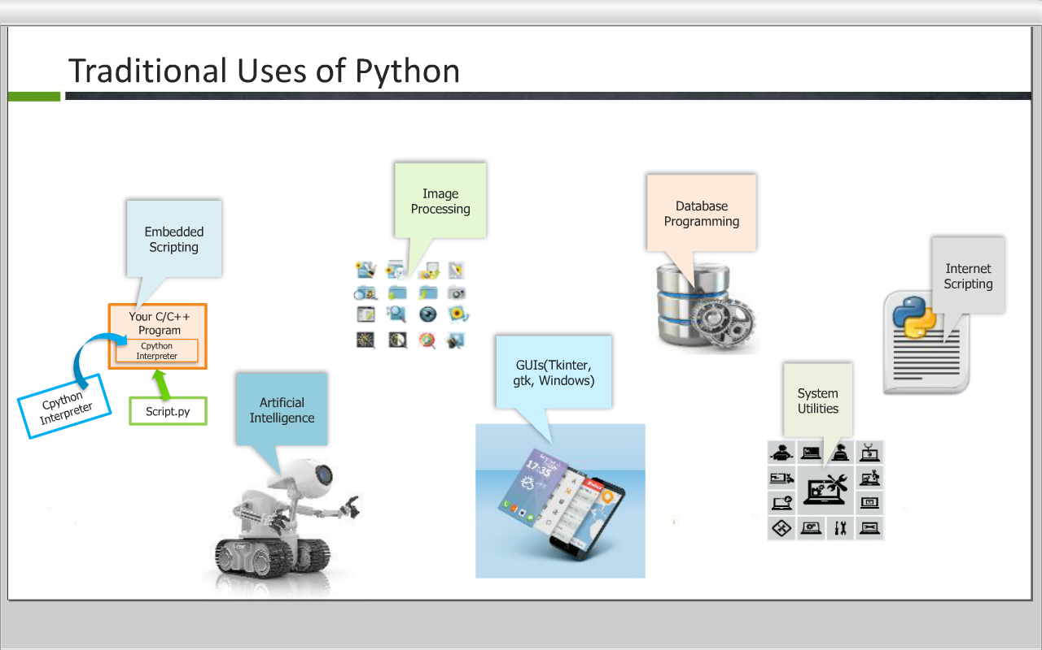

Slide 7
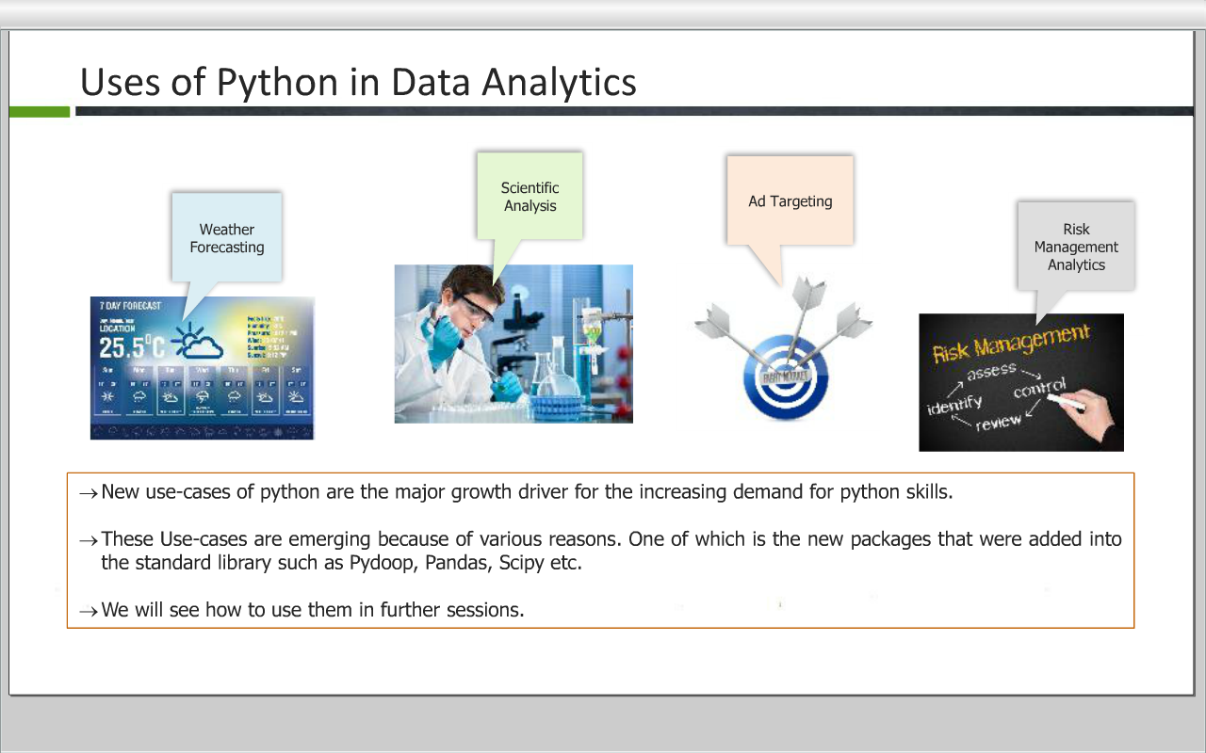

Slide 8
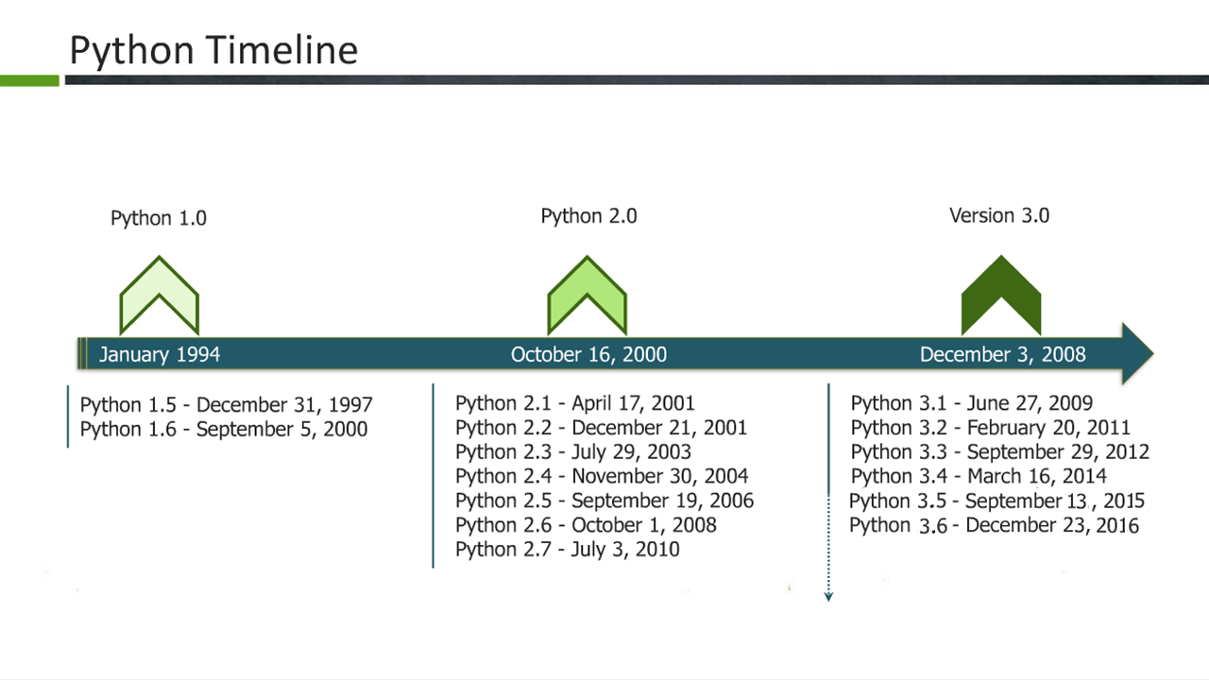

Slide 9
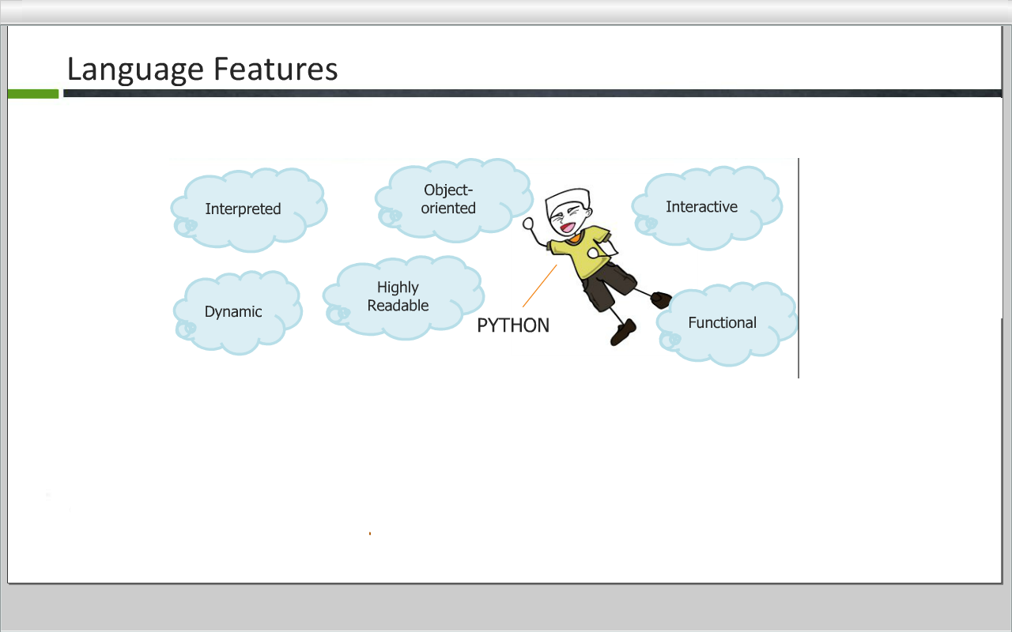

Slide 10
Installing Python
Python is pre-installed on most Unix systems, including Linux and MAC OS X
But for in Windows Operating Systems , user can download from the
https://www.python.org/downloads/

Slide 11
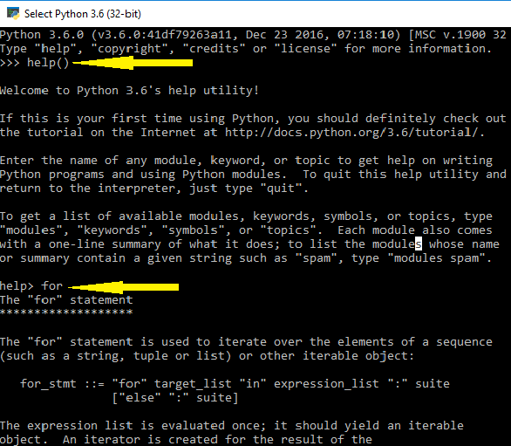
Getting Help in Python
Python interpreter has a built-in function called help(‘Object’). This function is intended for interactive use which invokes the help system.
To use this function, type – help() or help(‘Object’)
To exit the help press ‘q’
For Example:
Run help(‘for’) – This displays the help for the for function.

Slide 12
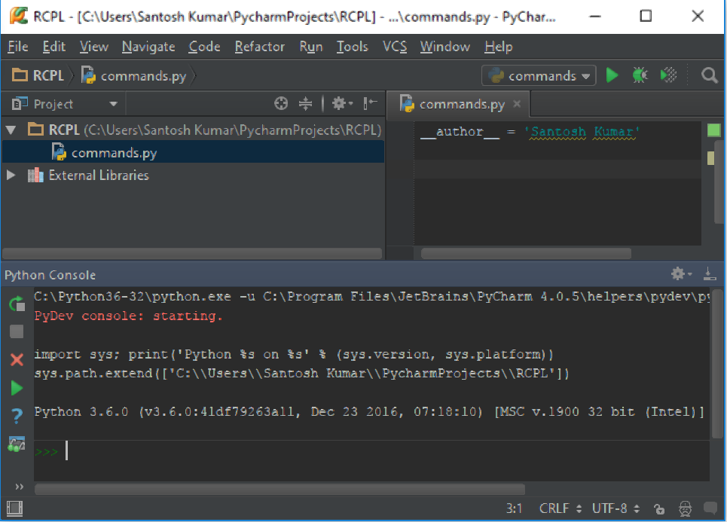
Python IDE
IDE is “Integrated Development Environment” which is used as the code editor, including a series of peripheral components and attachments.
The most important feature of the Python IDE is beyond ordinary text editor, it offers a variety of language-specific shortcut editing functions which make it fast and comfortable for programmers while coding.
The IDE that we will be using is Pycharm.

Slide 13
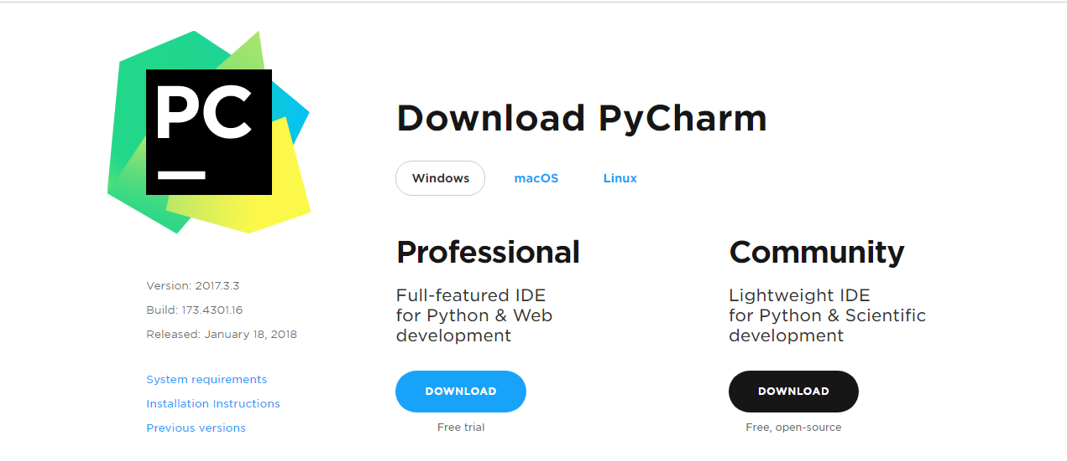
Python IDE
You can download Pycharm from below link :
http://www.jetbrains.com/pycharm/download/

Slide 14
Starting Python
There are two modes for using the Python interpreter:
Interactive Mode
Script Mode

Slide 15
Basic of Python

Slide 16
Keywords
Keywords are reserved words in Python and used to perform an internal operation. All the keywords of Python contain lower-case letters only.
List of Keywords:
False True None or and
in is as del if
else for while break continue
return def yield global not
lambda from import with elif
class try except assert finally
raise pass nonlocal

Slide 17
Identifier
Python Identiﬁers: Rules for Variable names
A Python Identifier is a name used to identify a variable, function, class, module or other object.
An identifier starts with a letter A to Z or a to z or an underscore (_) followed by zero or more letters, underscores and digits (0 to 9).
Python is a case sensitive programming language.
Python does not allow special characters such as @, $ and % within identifiers.
Variables are used by just assigning them a value. No declaration or data type definition is needed/used.

Slide 18
Variables
Python is completely object oriented, and not "statically typed". You do not need to declare variables before using them, or declare their type. Every variable in Python is an object.
Variable assignment:
We use the assignment operator (=) to assign values to a variable. Any type of value can be assigned to any valid variable.
For Example :
a = 5
b = 10.5
c = “Hello”

Slide 19
Data Types
Everything in Python programming is an object, and each object has its own unique identity(a type and a value).
There are many built-in data types available in Python.
Some important Data Types are:
Numbers
Boolean (bool)
Strings
Tuples
Lists
Sets
Dictionaries

Slide 20
Types of Numbers
Python supports following numeric types:
Integer
Decimal
Example : 0,1,124,-56,999999999999999
Binary
Start with 0b
Example: 0b1001
Octal
Start with 0o
Example: 0o86
Hex
Start with 0x
Example: 0x9fff

Slide 21
Type of Number (Cont…)
Floating Point Number:
Example : 1.0, 1e10,3.14e-2,6.99E4
Complex Number:
Example : 2+3j, 2j, 2.0+3.0j

Slide 22
Type Conversion
Sometimes it is necessary to convert values from one type to another. Python provides a few simple functions that will allow us to do that.
Function | Description
int(x [,base]) | Converts x to an integer. base specifies the base if x is a string.
float(x) | Converts x to a floating-point number.
complex(real [,imag]) | Creates a complex number.
str(x) | Converts object x to a string representation.
eval(str) | Evaluates a string and returns an object.
tuple(s) | Converts s to a tuple.
list(s) | Converts s to a list.
set(s) | Converts s to a set.
dict(d) | Creates a dictionary. d must be a sequence of (key,value) tuples.

Slide 23
Literals
Literal Constants: The number or string that represent itself.
Example: The number 2 always represent itself and nothing else – it is a constant because its value cannot be changed.

